Slide 1

Application of SafeML for Building Trustworthy and Explainable Machine Learning (ML) Classifiers
Koorosh Aslansefat,
Email: k.aslansefat@hull.ac.uk

Slide 2
Table of Content
What I am going to discuss
Introduction
Brief Introduction on AI Safety
Statistical Distance Measures
ECDF-based Statistical Distance Measures
SafeML Idea
SafeML: An Approach for Safety Assurance of Machine Learning Classifiers through Statistical Difference Measure
Numerical Results and Conclusion
Case studies, Numerical Results and Conclusion
2

Slide 3

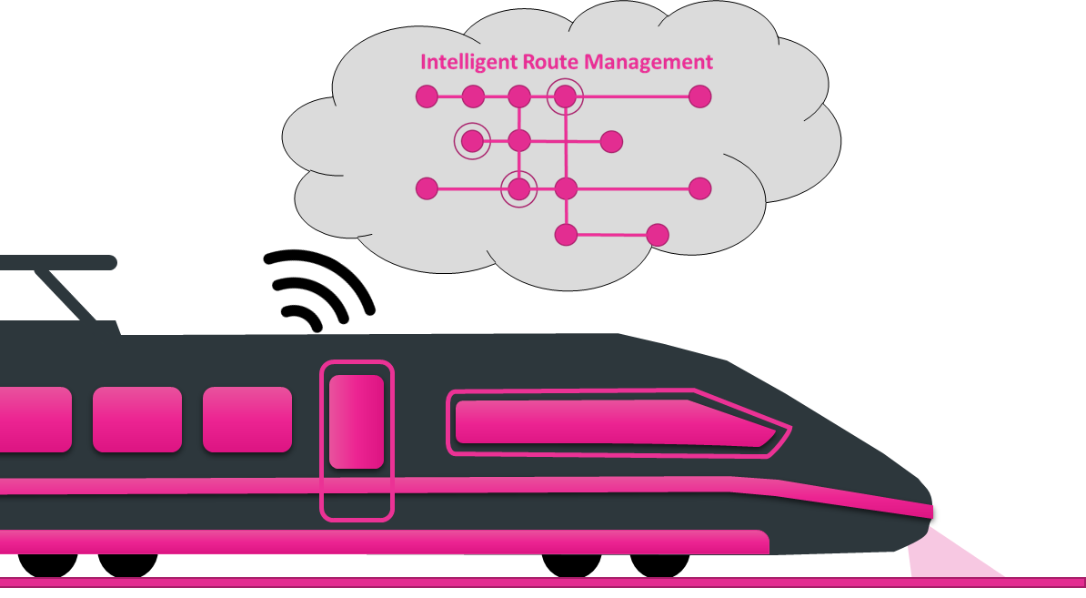

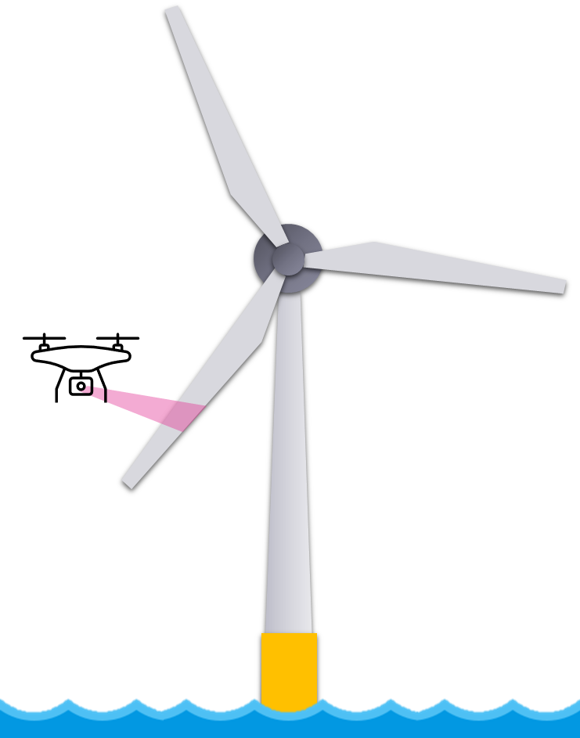
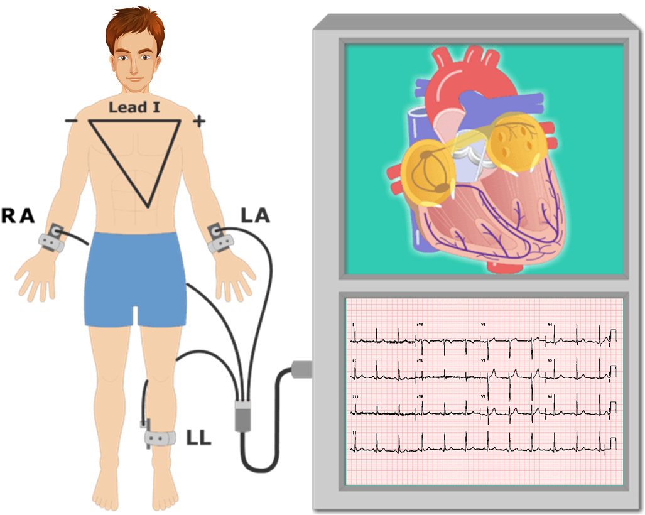
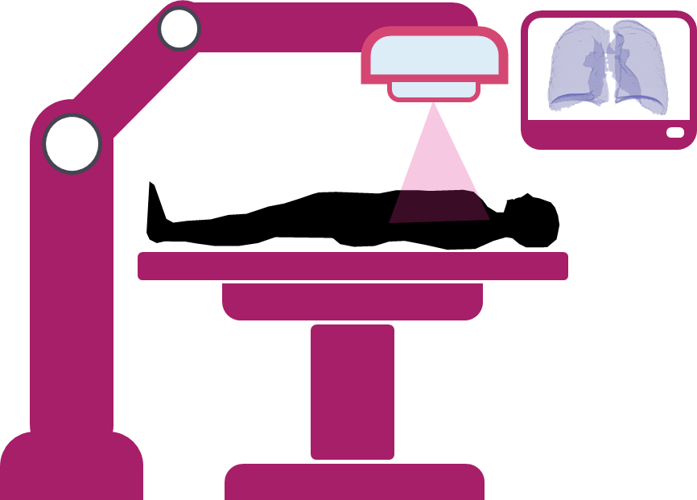

Slide 4
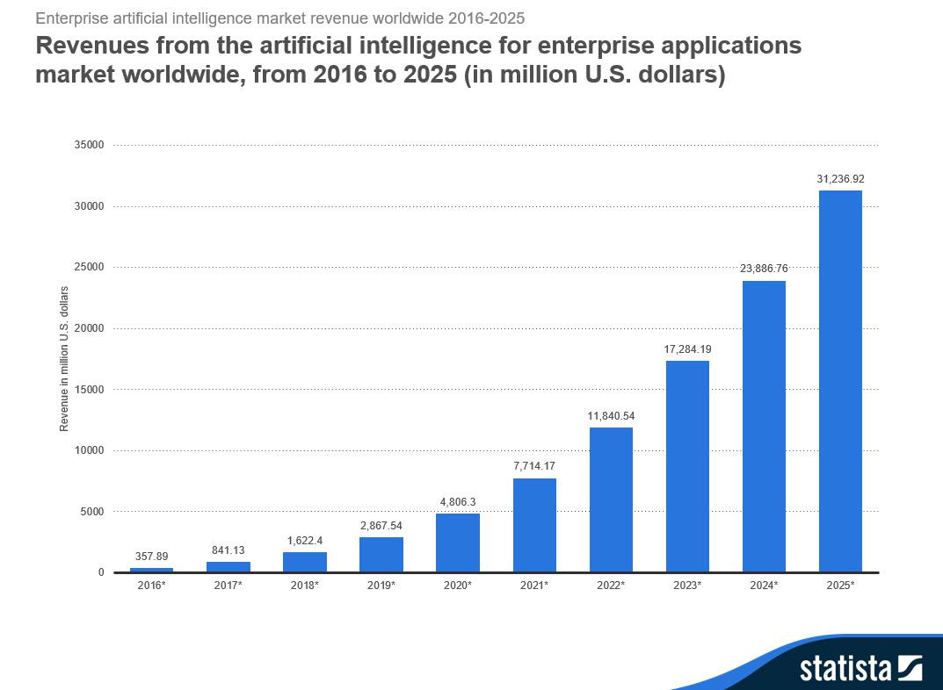
https://www.statista.com/statistics/721747/worldwide-artificial-intelligence-market
4

Slide 5
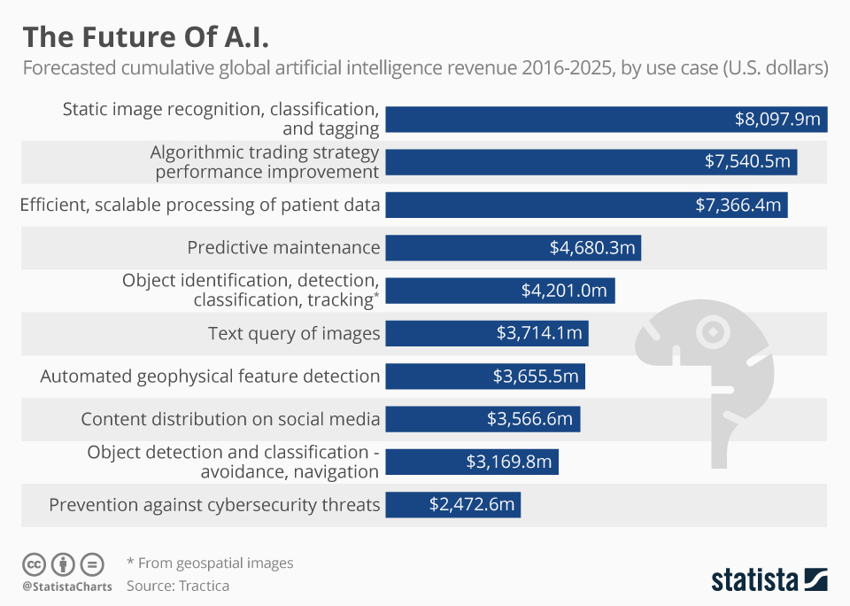
https://www.statista.com/chart/6810/the-future-of-ai/
5

Slide 6
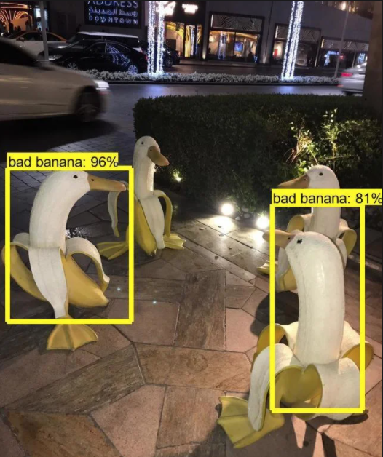
SafeML Problem Statement
https://www.reddit.com/r/ProgrammerHumor/comments/cl2rve/so_a_friend_of_mine_was_working_on_an_opencvml/
6

Slide 7
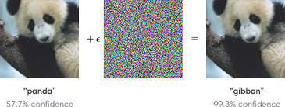
Adversarial Attack
https://openai.com/blog/adversarial-example-research/
7

Slide 8
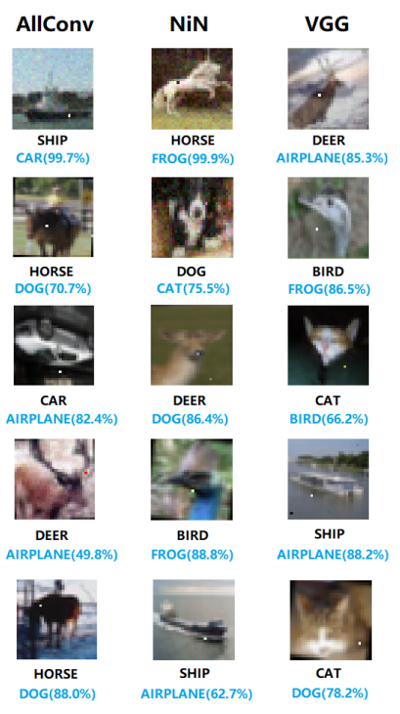
SafeML Problem Statement
Su, J., Vargas, D. V., & Sakurai, K. (2019). One pixel attack for fooling deep neural networks. IEEE Transactions on Evolutionary Computation, 23(5), 828-841.
8

Slide 9
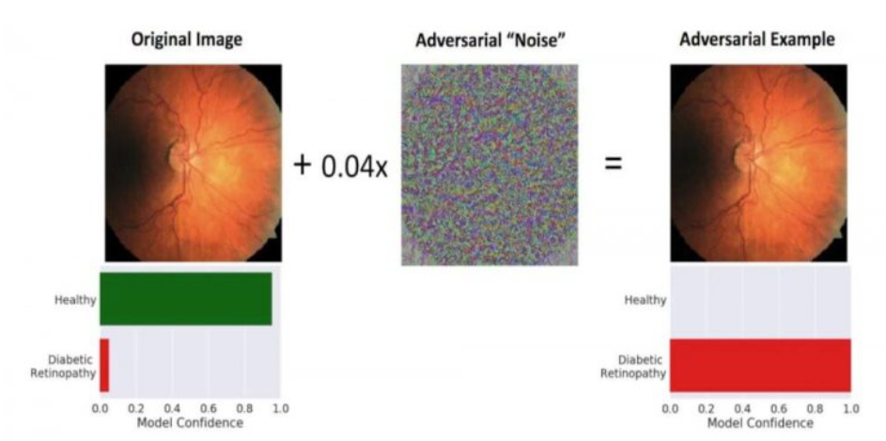
Adversarial Attack on Medical Applications
https://catalyst.nejm.org/videos/health-superpowers-ai-good/
9

Slide 10
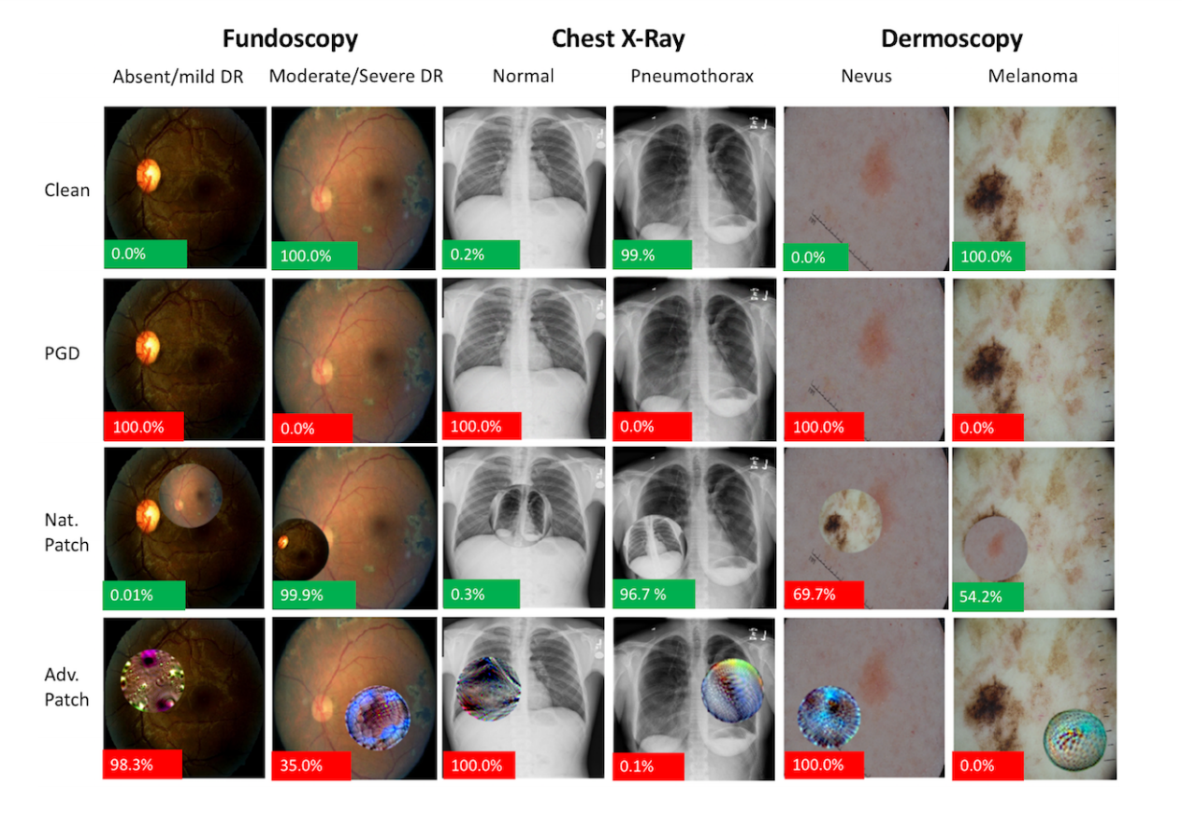
Adversarial Attack on Medical Applications
Finlayson, S. G., Bowers, J. D., Ito, J., Zittrain, J. L., Beam, A. L., & Kohane, I. S. (2019). Adversarial attacks on medical machine learning. Science, 363 (6433), 1287-1289.
10

Slide 11
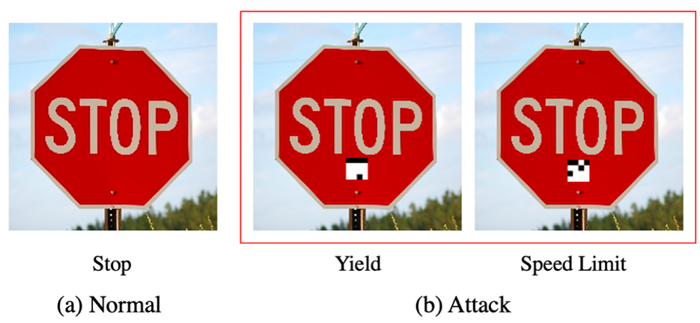
Adversarial Attack on Traffic Sign Recognition
https://portswigger.net/daily-swig/trojannet-a-simple-yet-effective-attack-on-machine-learning-models
11

Slide 12
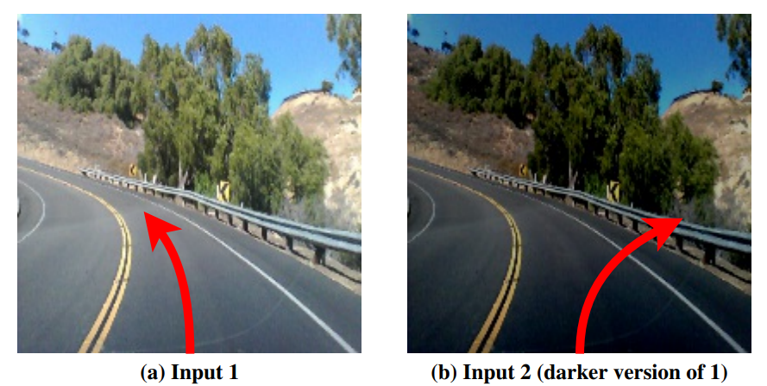
SafeML Problem Statement
K. Pei, et al. K., Cao, Y., Yang, J., & Jana, S. (2017). Deepxplore: Automated whitebox testing of deep learning systems. In proceedings of the 26th Symposium on Operating Systems Principles (pp. 1-18).
12

Slide 13
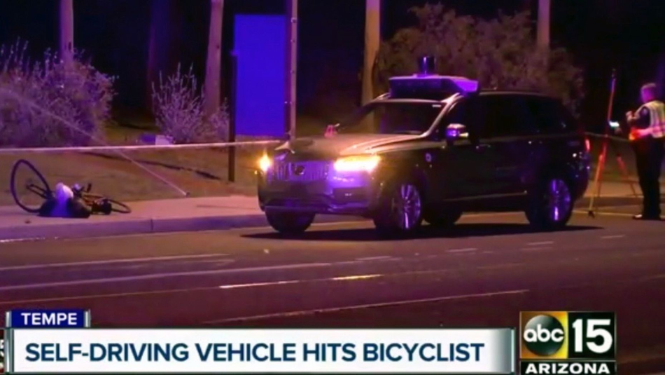
Uber Self-driving Car Kills a Bicyclist
10 AI Failures in 2018Review:, https://medium.com/syncedreview/2018-in-review-10-ai-failures-c18faadf5983
13

Slide 14
Critical Situations
Safety-Critical
Budget-Critical
Environment-Critical
Privacy-Critical
14

Slide 15
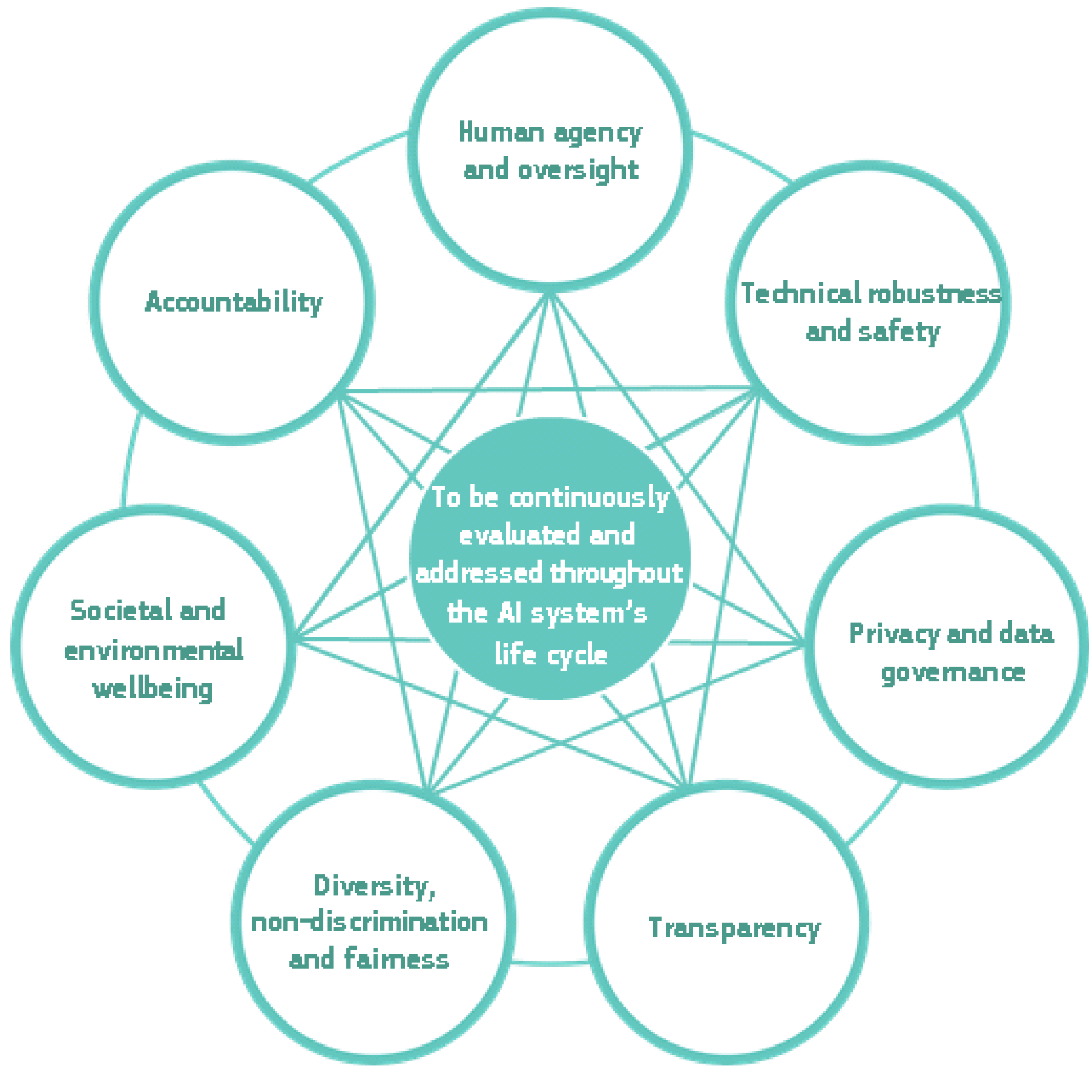
Trustworthy AI
EU Ethics Guidelines for Trustworthy AI:
https://ec.europa.eu/digital-single-market/en/news/ethics-guidelines-trustworthy-ai

Slide 16
AI Safety Issues
AI Safety
Safe exploration
Robustness to distributional shift
Avoiding negative side effects
Avoiding “reward hacking” and “wire heading”
Scalable oversight
Amodei et al. (2016). Concrete Problems in AI Safety.
16

Slide 17
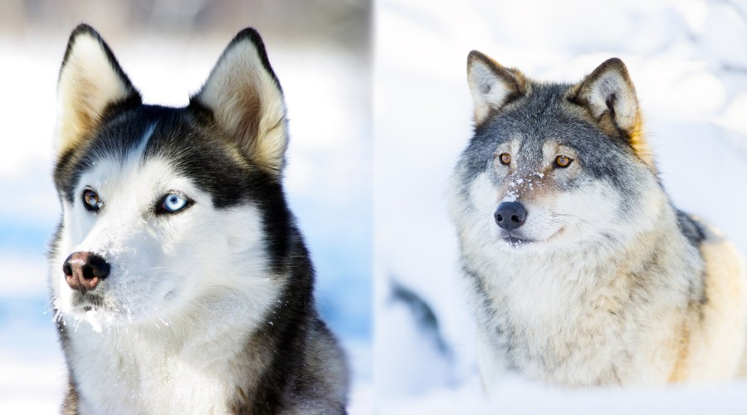
Husky vs. Wolf
Ribeiro, M. T., Singh, S., & Guestrin, C. (2016, August). " Why should i trust you?" Explaining the predictions of any classifier. In Proceedings of the 22nd ACM SIGKDD international conference on knowledge discovery and data mining (pp. 1135-1144).
https://theblue.ai/blog/lime-models-explanation/

Slide 18
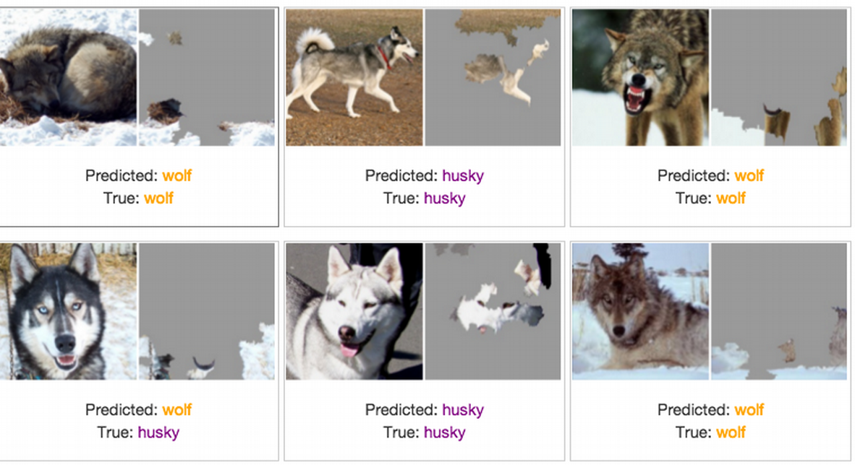
LIME:
Local
Interpretable
Model-agnostic Explanations
Ribeiro, M. T., Singh, S., & Guestrin, C. (2016, August). " Why should i trust you?" Explaining the predictions of any classifier. In Proceedings of the 22nd ACM SIGKDD international conference on knowledge discovery and data mining (pp. 1135-1144).
https://theblue.ai/blog/lime-models-explanation/

Slide 19
SafeML Idea
19

Slide 20
SafeML Project Goal
Accuracy Estimation
Estimating the ML Classifier Accuracy through Statistical Differences
Safety Monitoring
Safety Monitoring through a proposed human-in-loop procedure
XAI: Explainable Artificial Intelligence
Providing Explainable Artificial Intelligence using Statistical Differences
20

Slide 21
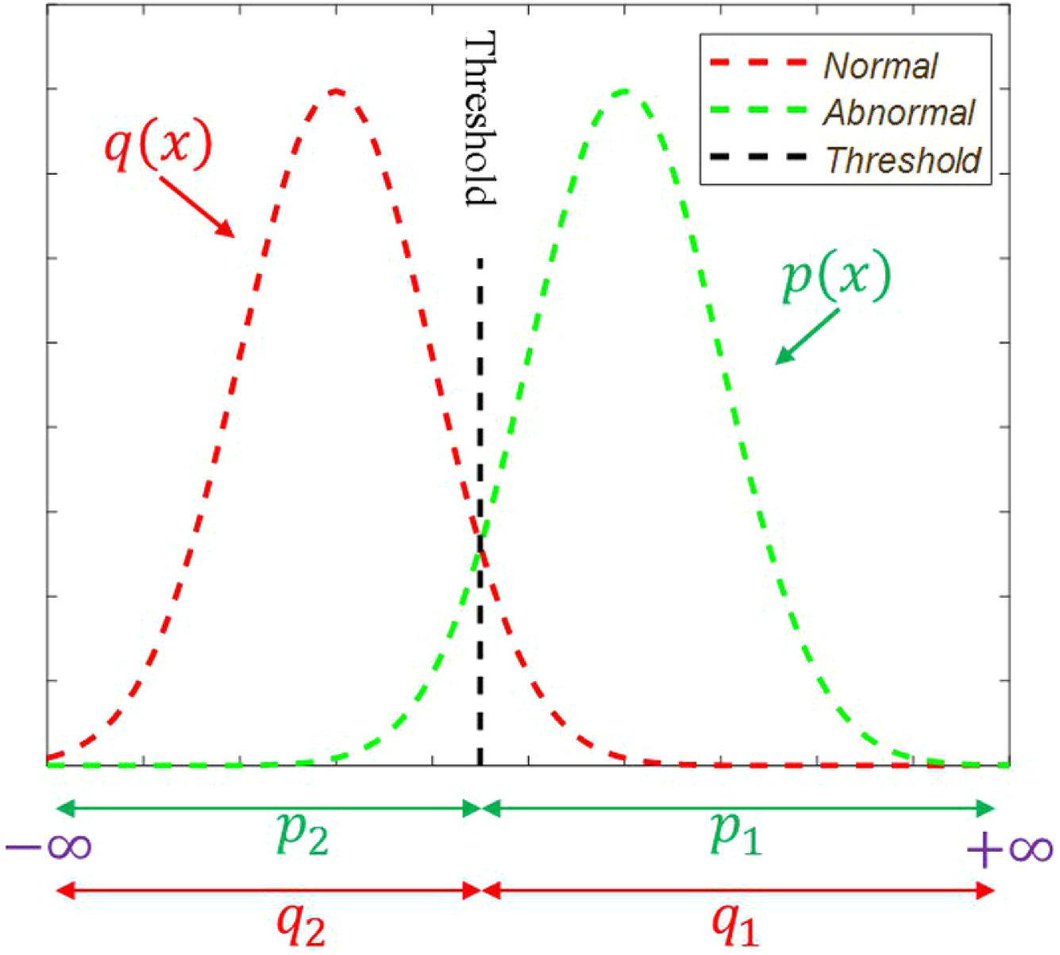
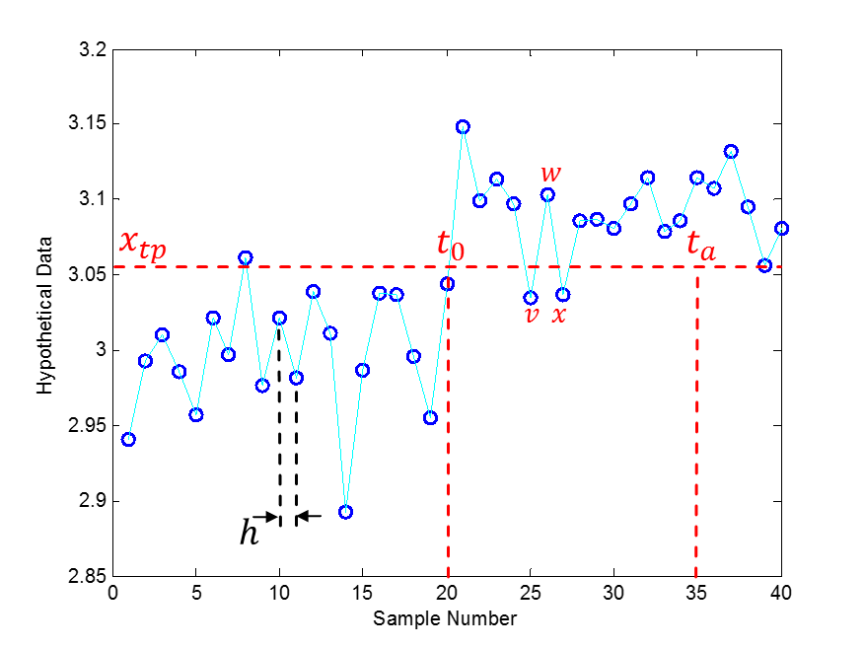
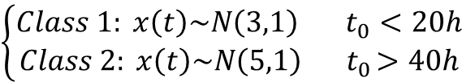
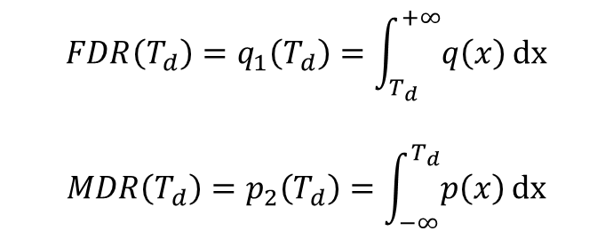
A Hypothetical Example
$$\left\{\begin{aligned}Class 1: x\left(t\right)\sim N\left(3,1\right) t_{0}<20h \\ Class 2: x\left(t\right)\sim N\left(5,1\right){ t}_{0}>40h\end{aligned}\right.$$
$${FDR\left(T_{d}\right)=q}_{1}\left(T_{d}\right)=\int_{T_{d}}^{+∞}{q\left(x\right)}dx$$
$${MDR\left(T_{d}\right)=p}_{2}\left(T_{d}\right)=\int_{−∞}^{T_{d}}{p\left(x\right)}dx$$
21

Slide 22


Probability Density Functions
Consider a hypothetical one dimensional data with nine classes
Mean Distance
Class 2
Class 1
Class 9
Cause Error
$$6σ$$
$$6σ$$
Variance Distance
22

Slide 23
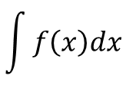
Probability Density Functions and Cumulative Functions
$$\int{f\left(x\right)dx}$$
Difference in Cumulative Distribution Functions
23

Slide 24
Cumulative Distribution Function (CDF) Distance Measures
Wasserstein
Kuiper
Anderson-Darling
Kolmogorov-Smirnov
Cramer-Von Mises
Wasserstein + Cramer-Von Mises (DTS)
24

Slide 25
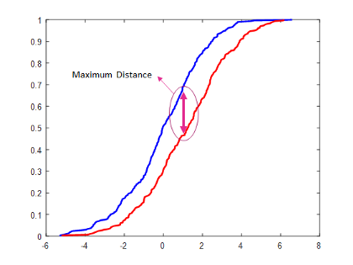
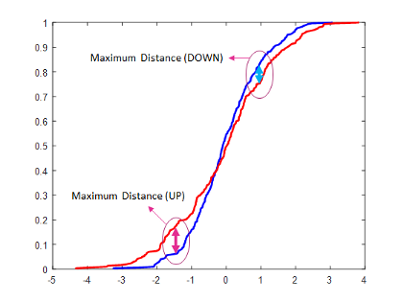
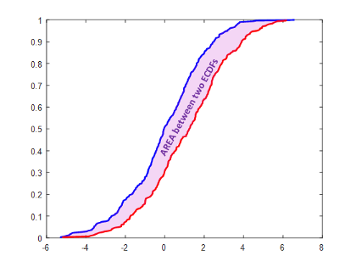
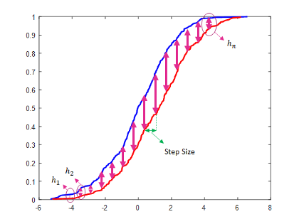
Cumulative Distribution Function (CDF) Distance Measures
Kolmogorov-Smirnov Distance
Kuiper Distance
Wasserstein Distance
Cramer-Von Mises Distance
25

Slide 26
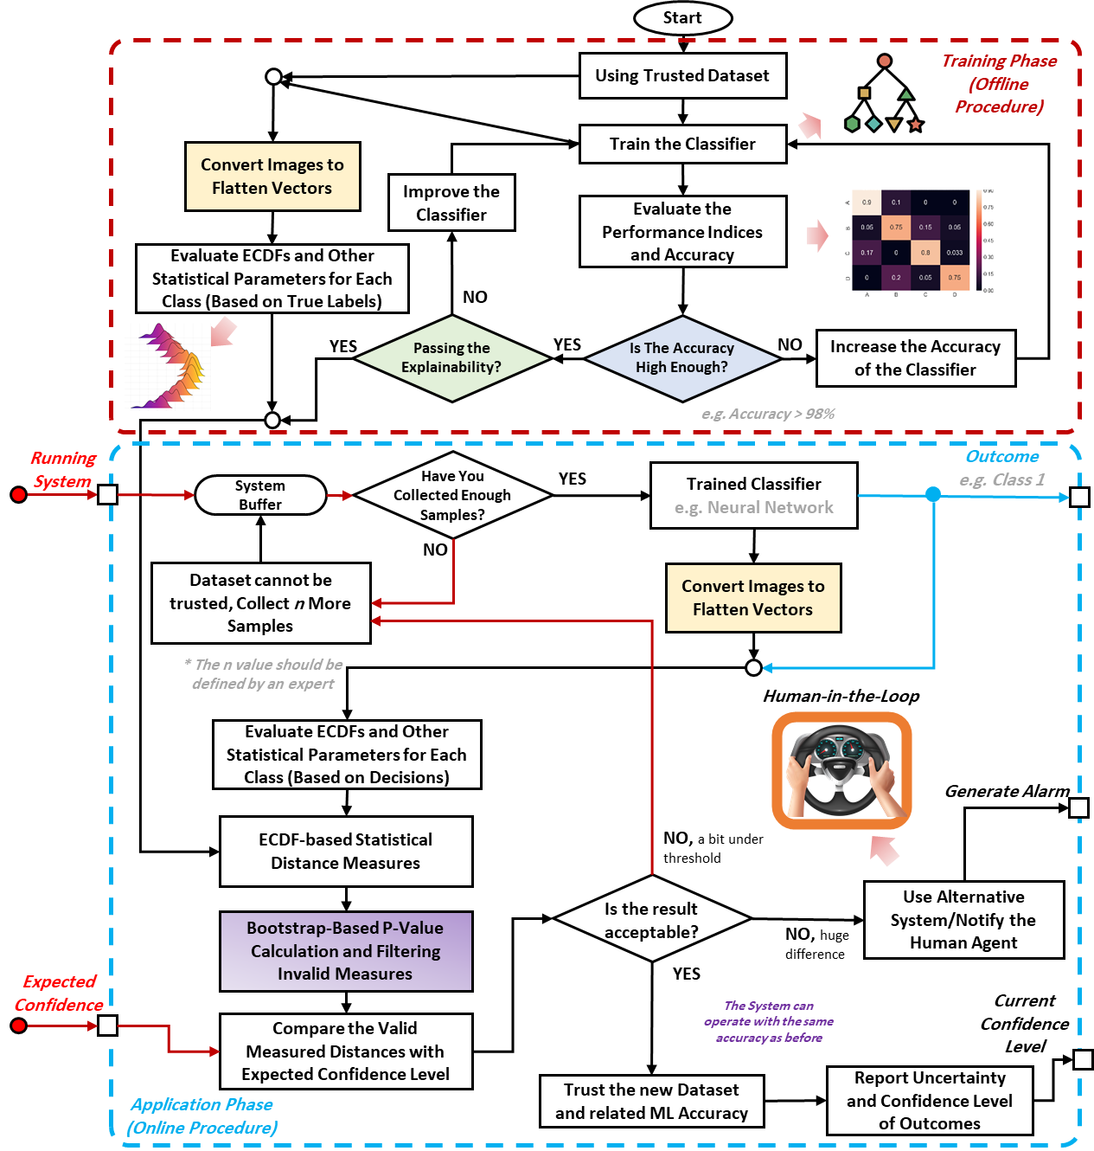
26

Slide 27
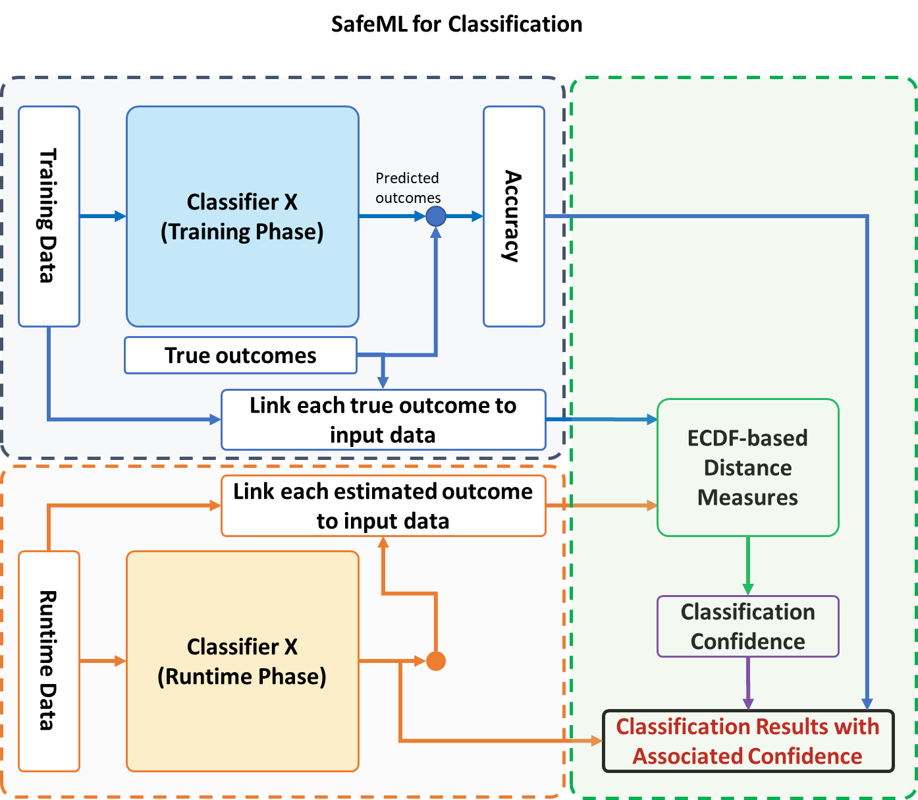
27

Slide 28
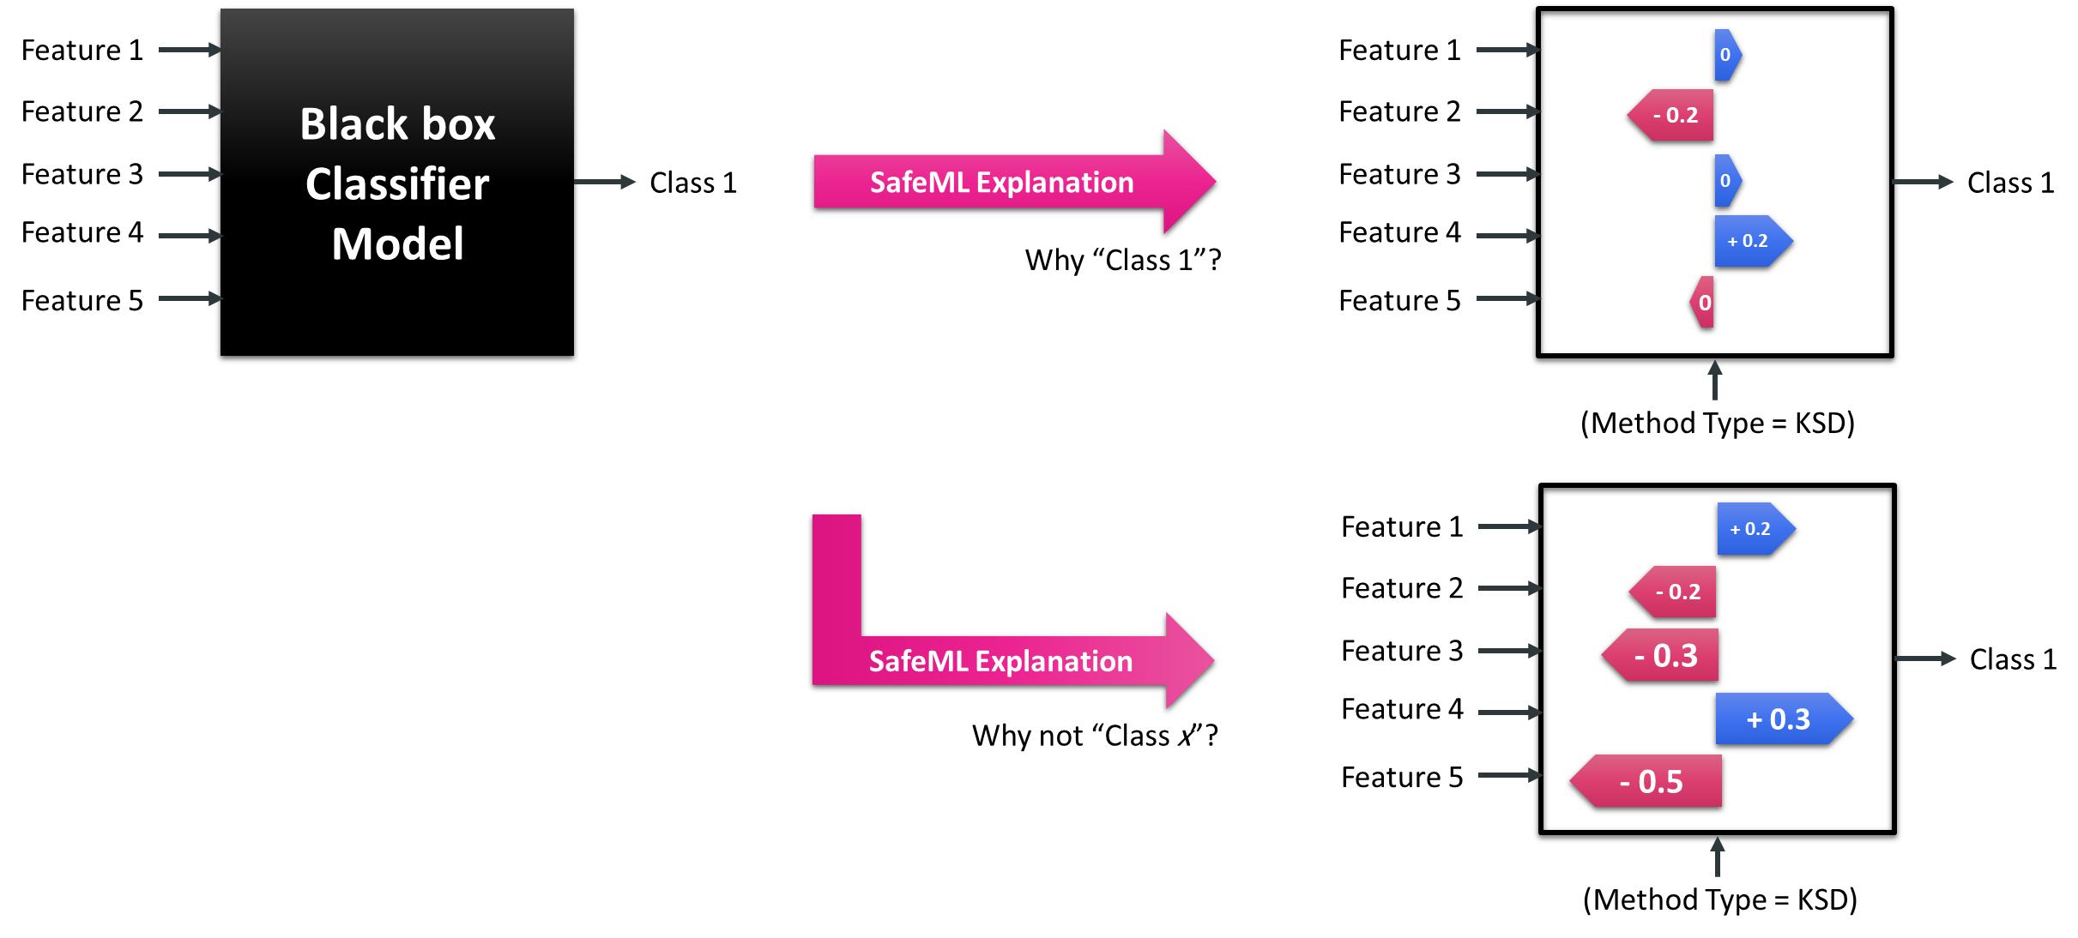
SafeML Toward eXplainable AI (XAI)
© K. Aslansefat 2020
28

Slide 29

Sit Dolor Amet
Examples and Applications

Slide 30
Cross-Validation and ML Classifiers
ML Classifiers
Linear discriminant analysis (LDA)
Classification and Regression Tree (CART)
Random Forest (RF)
K-Nearest Neighbours (KNN)
Support Vector Machine (SVM)
Cross Validation
K-Fold
K = 10
30
30

Slide 31
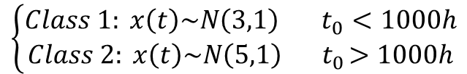
Example 1: 1D Normal Distributed Data in Two Classes
$$\left\{\begin{aligned}Class 1: x\left(t\right)\sim N\left(3,1\right) t_{0}<1000h \\ Class 2: x\left(t\right)\sim N\left(5,1\right){ t}_{0}>1000h\end{aligned}\right.$$
` | Kolmogorov-Smirnov | Kuiper | Anderson-Darling | Wasserstein | DTS | True Accuracy (Mean) | True Accuracy (Min)
LDA | 0.9125000 | 0.8375000 | 0.9885137 | 0.8764794 | 0.9595329 | 0.9691176 | 0.9375000
CART | 0.9110729 | 0.8405049 | 0.9896898 | 0.8801418 | 0.9620993 | 0.9569853 | 0.8750000
KNN | 0.9053426 | 0.8356562 | 0.9868039 | 0.8771581 | 0.9608425 | 0.9691176 | 0.8750000
SVM | 0.9053426 | 0.8356562 | 0.9868039 | 0.8771581 | 0.9608425 | 0.9569853 | 0.8750000
RF | 0.8530239 | 0.7897328 | 0.9686393 | 0.7933787 | 0.9346339 | 0.9386029 | 0.8235294
Difference with True Accuracy (Min)
 | Kolmogorov-Smirnov | Kuiper | Anderson-Darling | Wasserstein | DTS
LDA | 0.025000 | 0.100000 | 0.051014 | 0.061021 | 0.022033
CART | 0.036073 | 0.034495 | 0.11469 | 0.005142 | 0.087099
KNN | 0.030343 | 0.039344 | 0.111804 | 0.002158 | 0.085843
SVM | 0.030343 | 0.039344 | 0.111804 | 0.002158 | 0.085843
RF | 0.029495 | 0.033797 | 0.145110 | 0.030151 | 0.111105
Max Difference | 0.036073 | 0.100000 | 0.145110 | 0.061021 | 0.111105
31
31

Slide 32
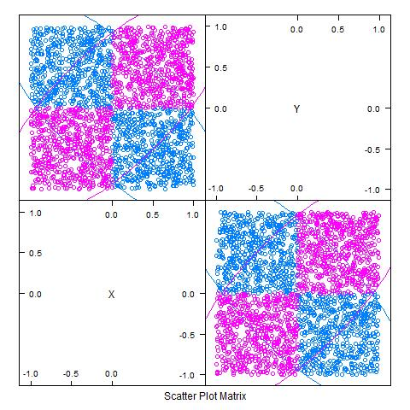
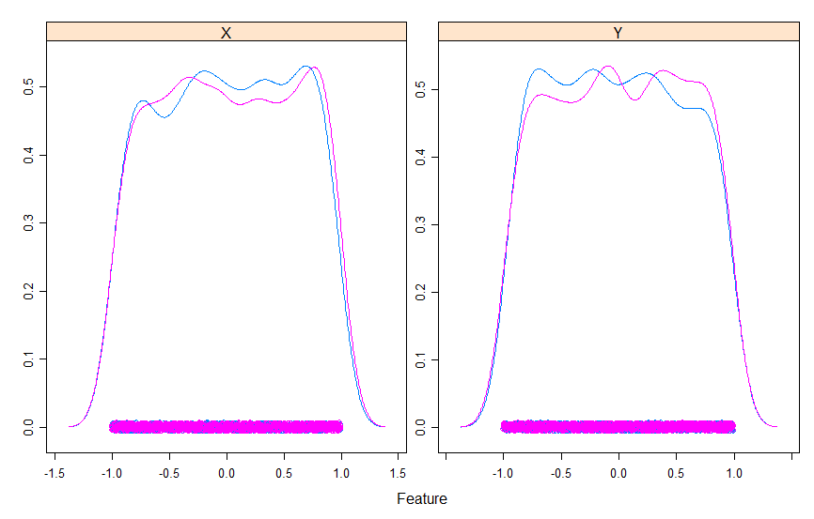
Example 2: 2D XOR Dataset
32
32

Slide 33
Example 2: 2D XOR Dataset
 | Kolmogorov-Smirnov | Kuiper | Anderson-Darling | Wasserstein | DTS | True Accuracy (Mean) | True Accuracy (Min)
LDA | 0.7722165 | 0.7706001 | 0.9028175 | 0.7550639 | 0.9856662 | 0.5912107 | 0.5083333
CART | 0.9281788 | 0.9219821 | 0.9877216 | 0.9254581 | 0.9952106 | 0.9941579 | 0.9874477
KNN | 0.9305751 | 0.9130628 | 0.9931512 | 0.9587683 | 0.9970757 | 0.9866649 | 0.9748954
SVM | 0.9310446 | 0.9175864 | 0.9934891 | 0.9581909 | 0.997064 | 0.9879166 | 0.9791667
RF | 0.9296264 | 0.9107489 | 0.9927418 | 0.9578211 | 0.9970175 | 0.9983333 | 0.9958333
 | Difference with True Accuracy (Min)
 | Kolmogorov-Smirnov | Kuiper | Anderson-Darling | Wasserstein | DTS
LDA | 0.263883 | 0.262267 | 0.394484 | 0.246731 | 0.477333
CART | 0.059269 | 0.065466 | 0.000274 | 0.06199 | 0.007763
KNN | 0.04432 | 0.061833 | 0.018256 | 0.016127 | 0.02218
SVM | 0.048122 | 0.06158 | 0.014322 | 0.020976 | 0.017897
RF | 0.066207 | 0.085084 | 0.003092 | 0.038012 | 0.001184
Max Difference | 0.263883 | 0.262266 | 0.394484 | 0.246730 | 0.477333
33
33
33

Slide 34
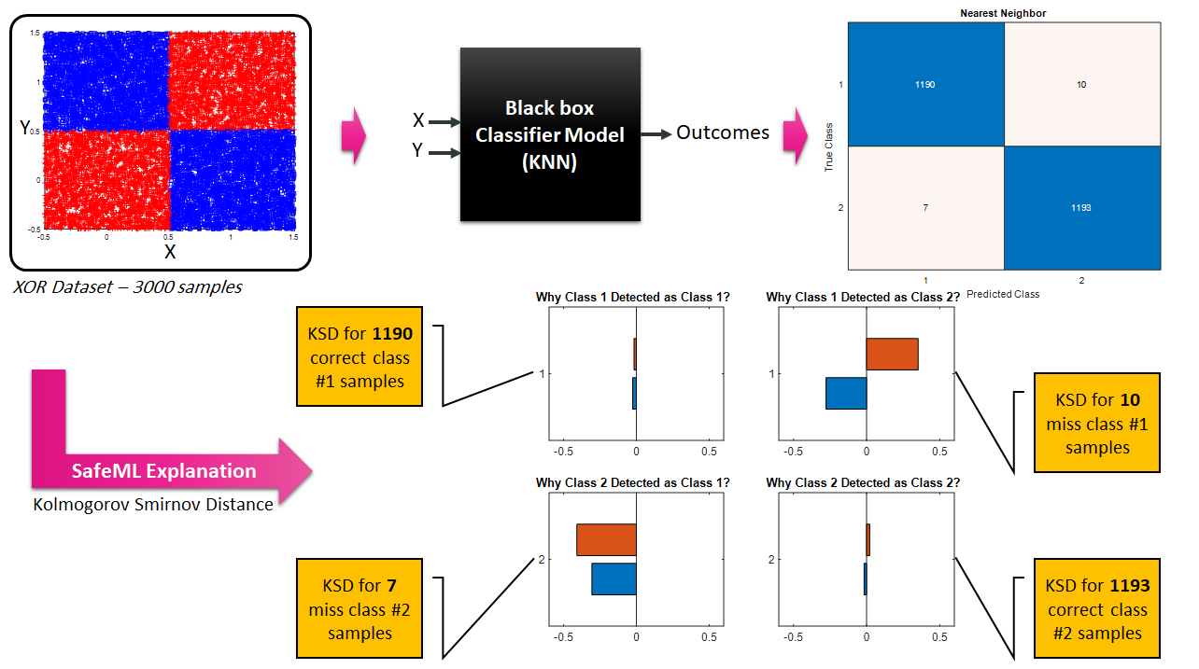
Example 2: 2D XOR Dataset
34
34
34

Slide 35
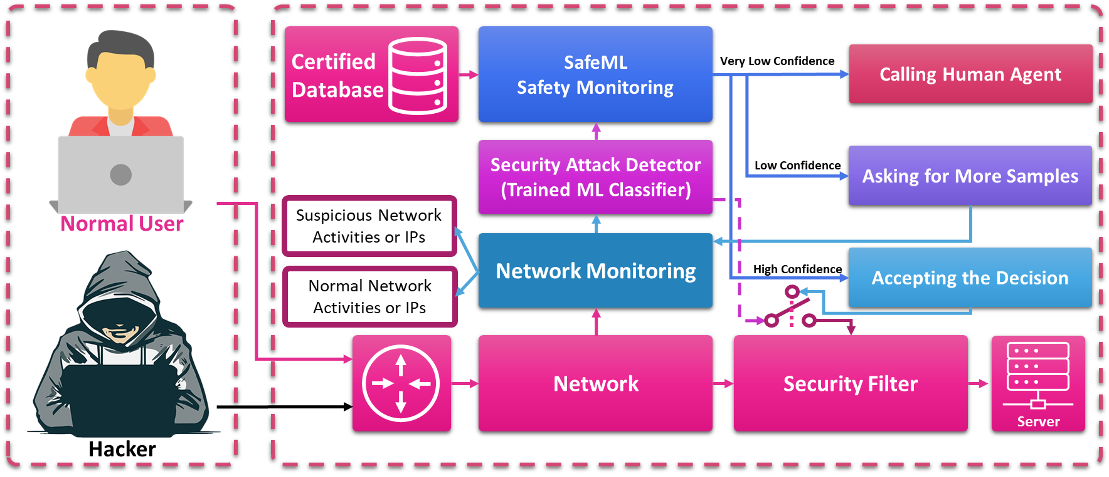
Application of SafeML in Security Intrusion Detection
35

Slide 36
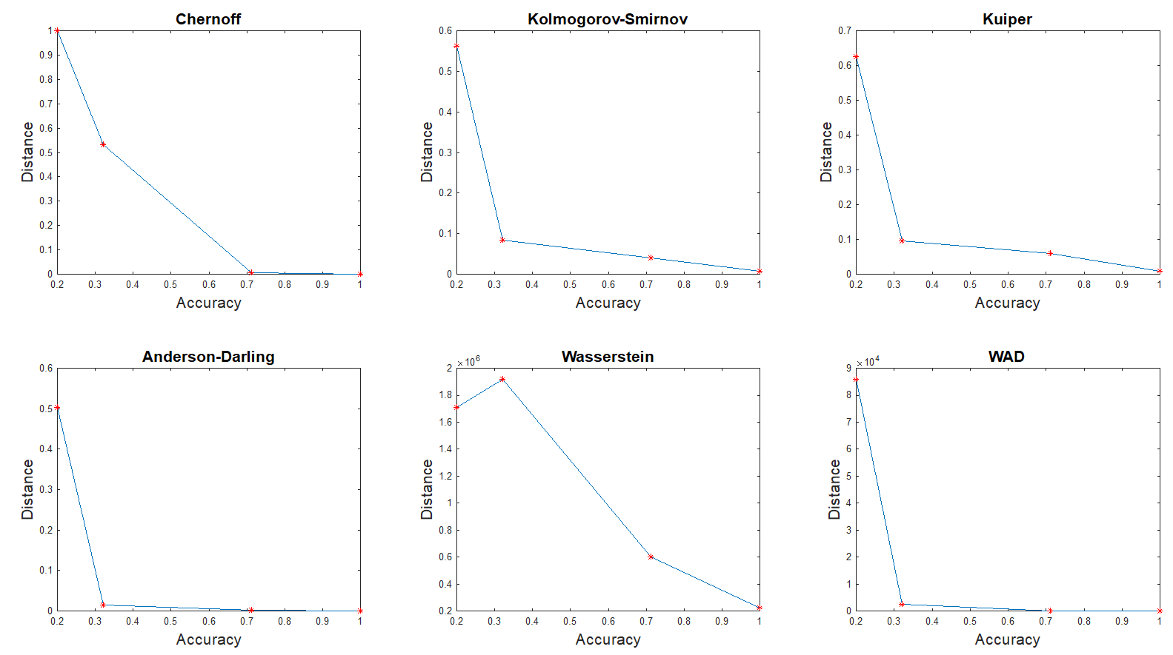
Example 3: Security Dataset
Intrusion Detection Evaluation Dataset (CIC-IDS2017)
36
36

Slide 37
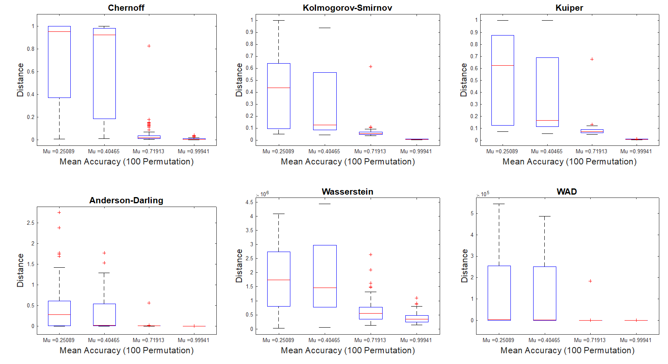
Example 3: Security Dataset
Intrusion Detection Evaluation Dataset (CIC-IDS2017)
37
37

Slide 38
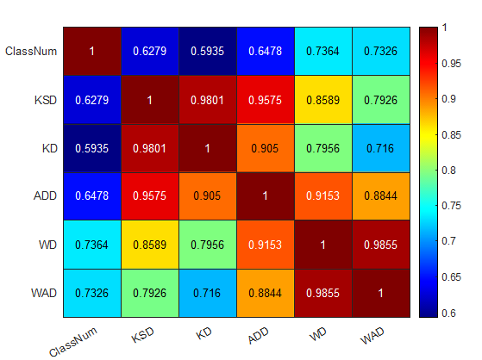
Example 3: Security Dataset
Intrusion Detection Evaluation Dataset (CIC-IDS2017)
38
38

Slide 39
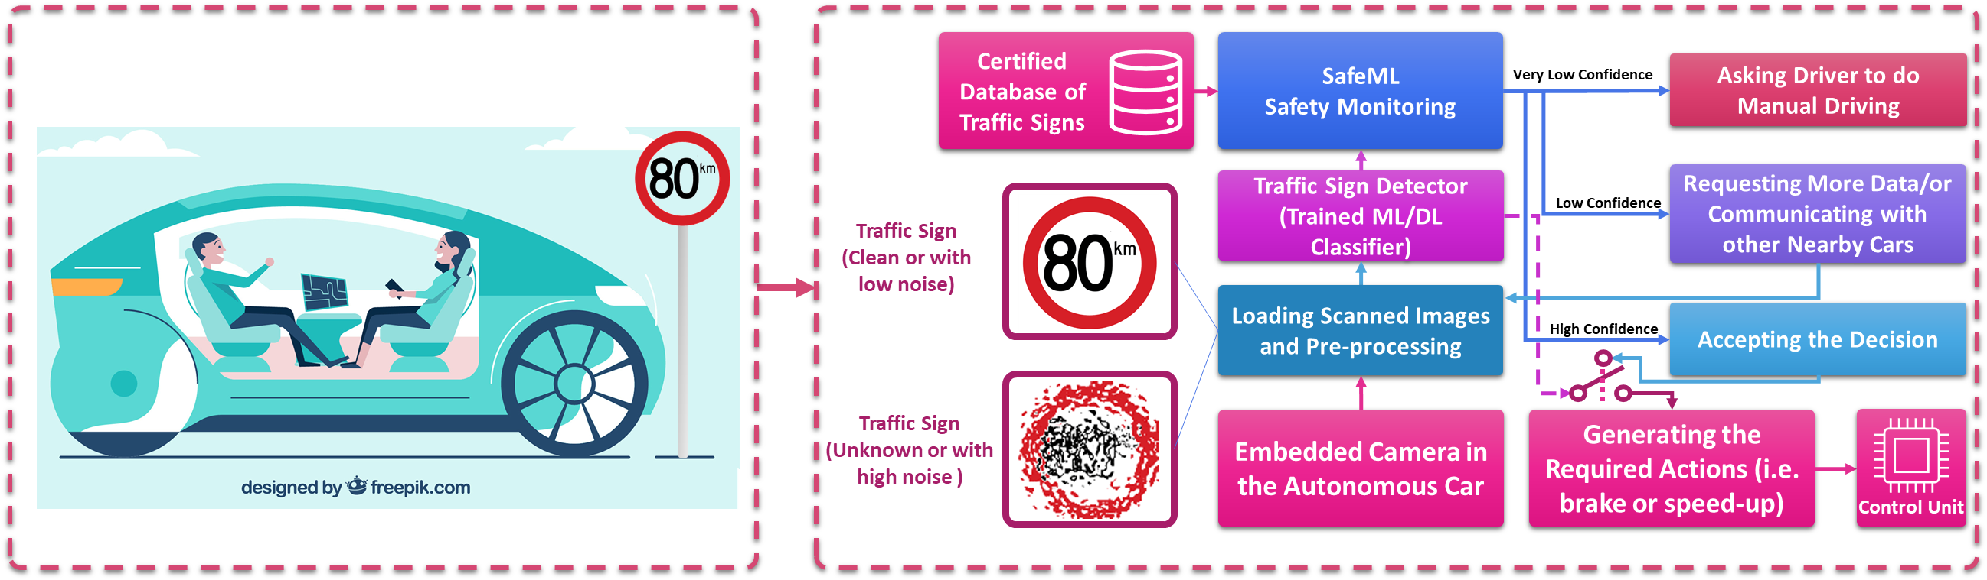
Applications of SafeML – Traffic Sign Detection and Speed Control
39

Slide 40
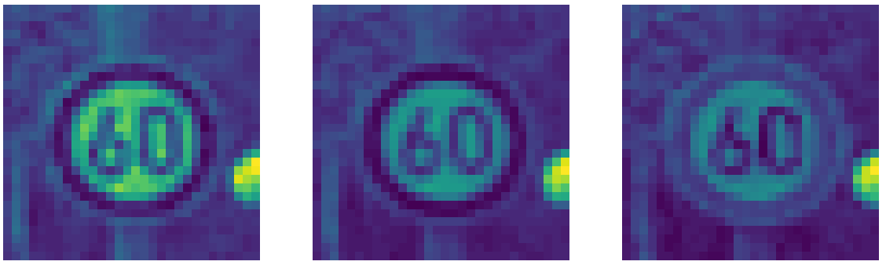
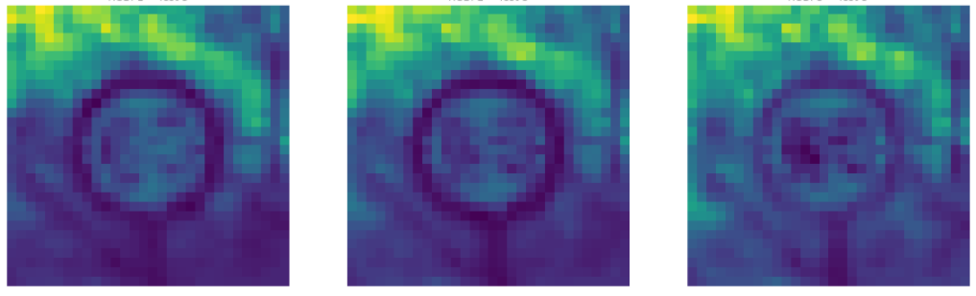
Applications of SafeML – Traffic Sign Detection and Speed Control
Red
Green
Blue
A sample that has been predicted correctly
A sample that has been predicted incorrectly
© K. Aslansefat 2020

Slide 41
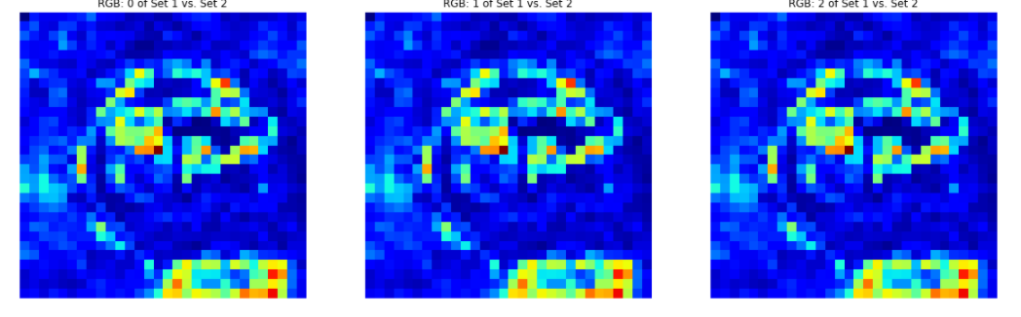
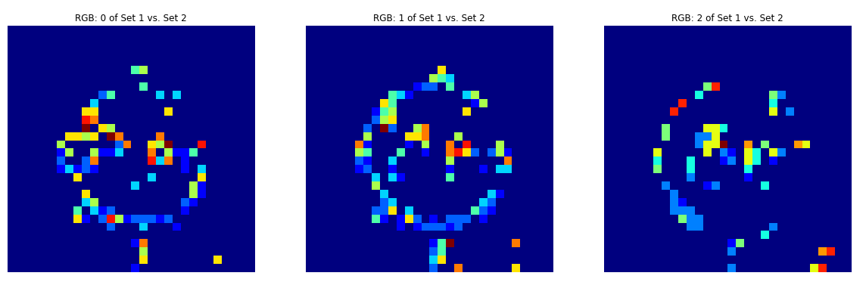
Applications of SafeML – Traffic Sign Detection and Speed Control
Red
Green
Blue
SafeML Statistical Distance Measure
(WD)
SafeML Statistical Distance Measure
(WD) with p-Value consideration
© K. Aslansefat 2020

Slide 42
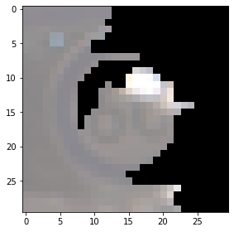
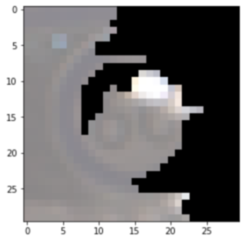
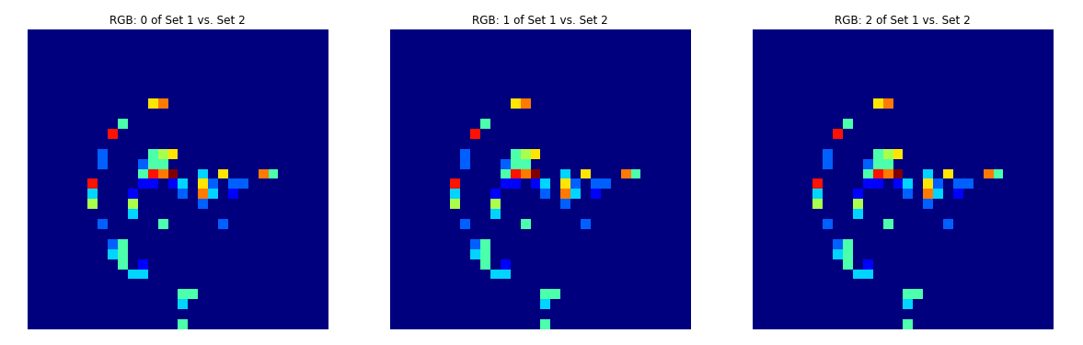
Red
Green
Blue
SafeML Statistical Distance Measure
(WD) with p-Value consideration
How LIME and SafeML are combined
X
=
SafeML Statistical Distance Measure
(WD) with p-Value consideration and Multiplied by LIME binary mask
© K. Aslansefat 2020

Slide 43
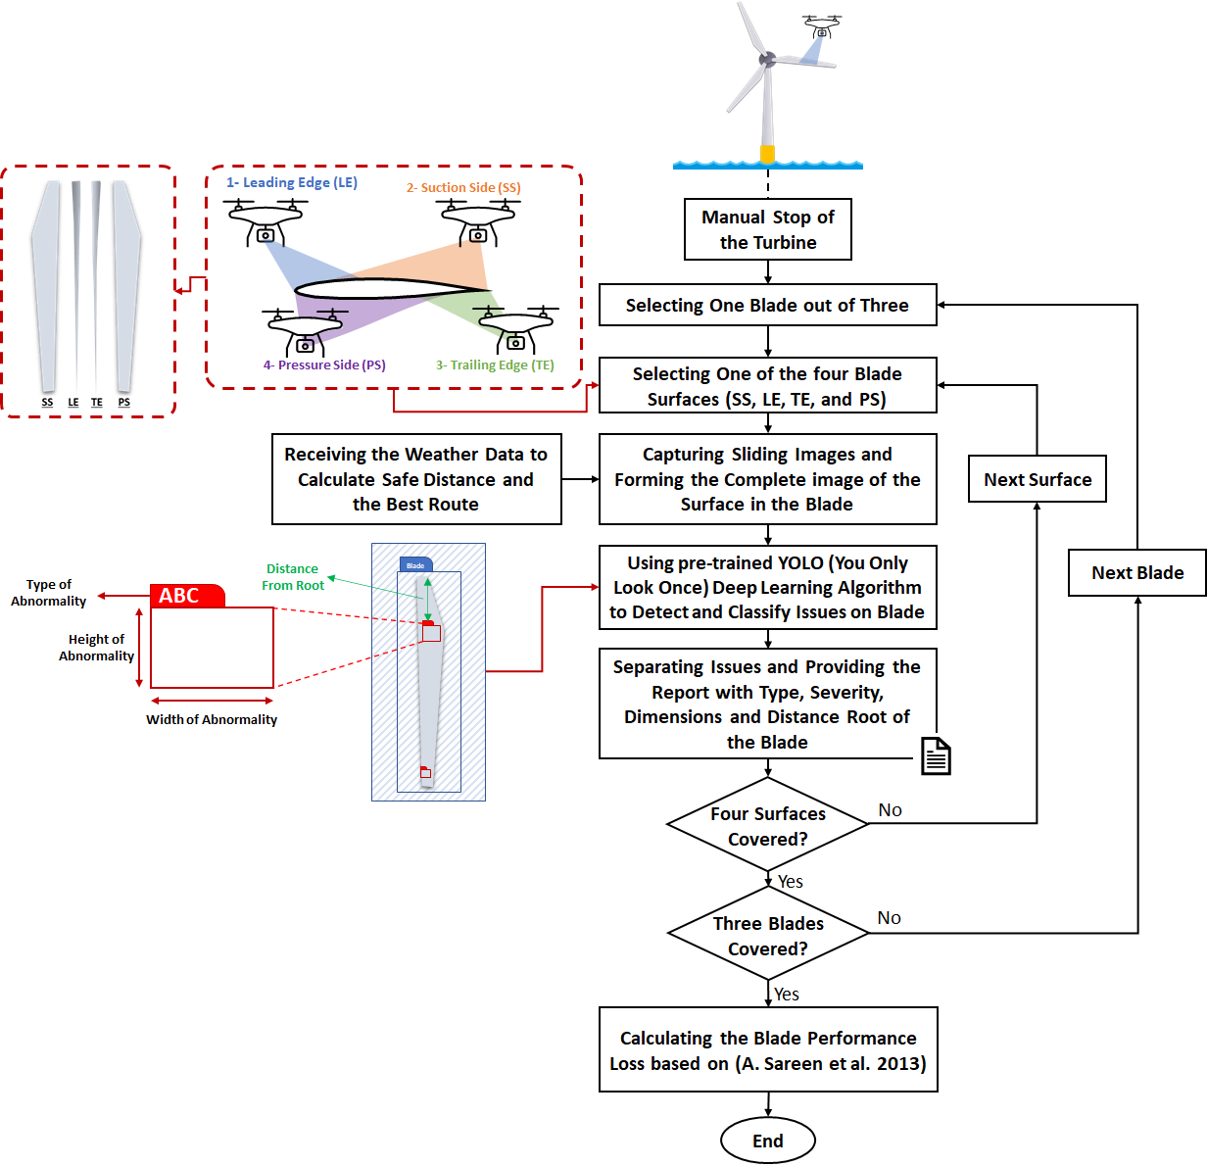
Applications of SafeML:
Blade Inspection and Diagnosis

Slide 44
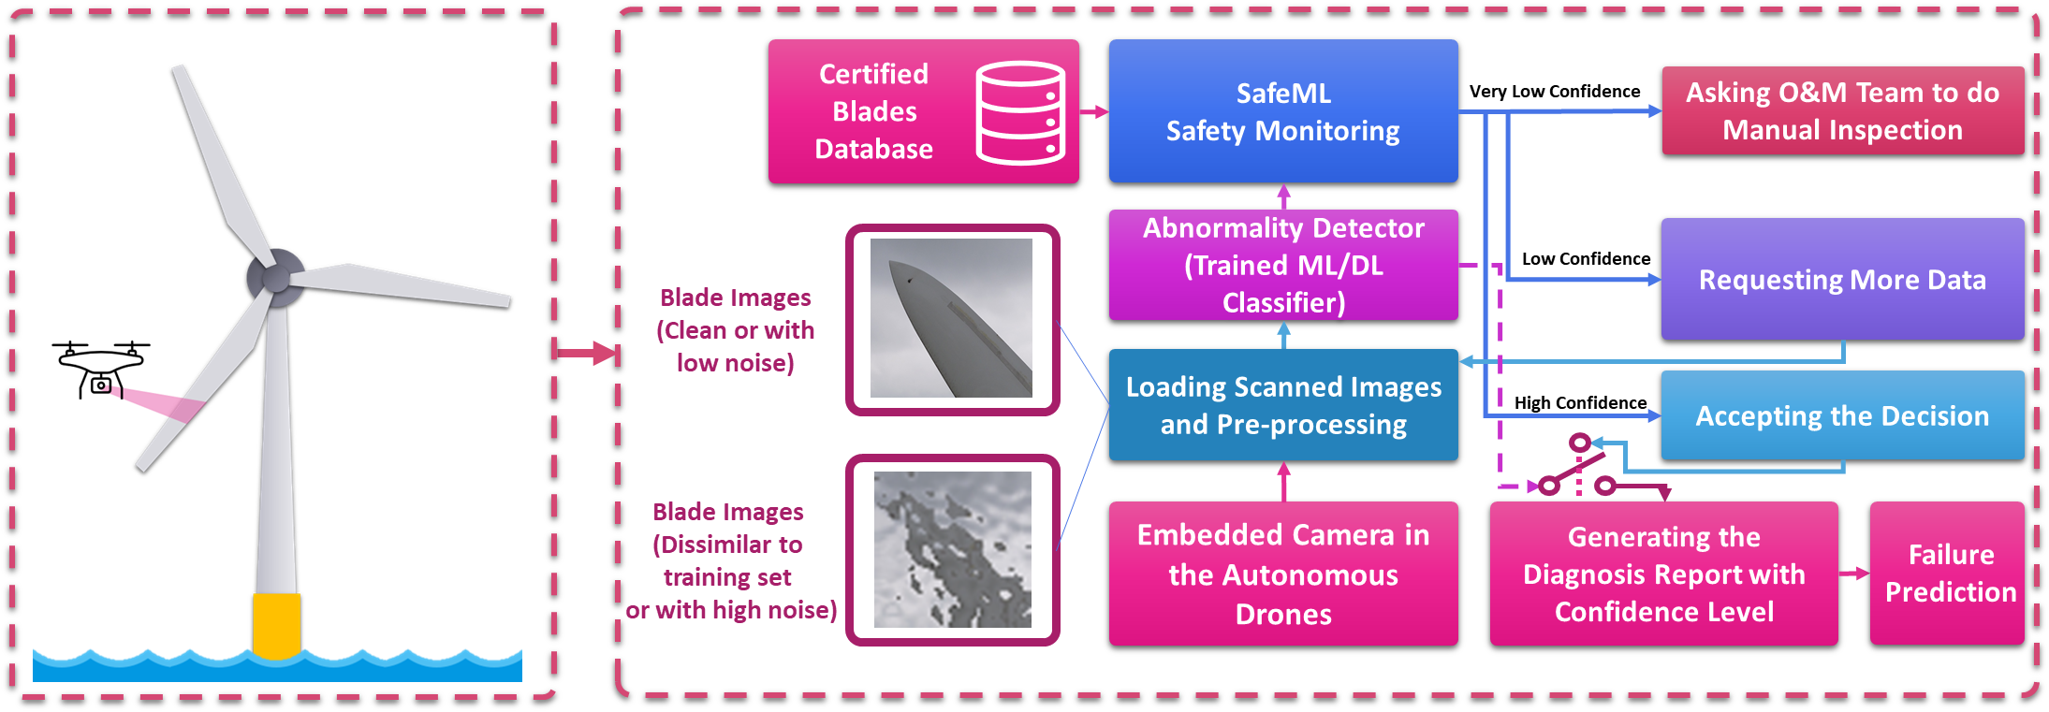
Applications of SafeML – Blade Inspection and Diagnosis
44

Slide 45
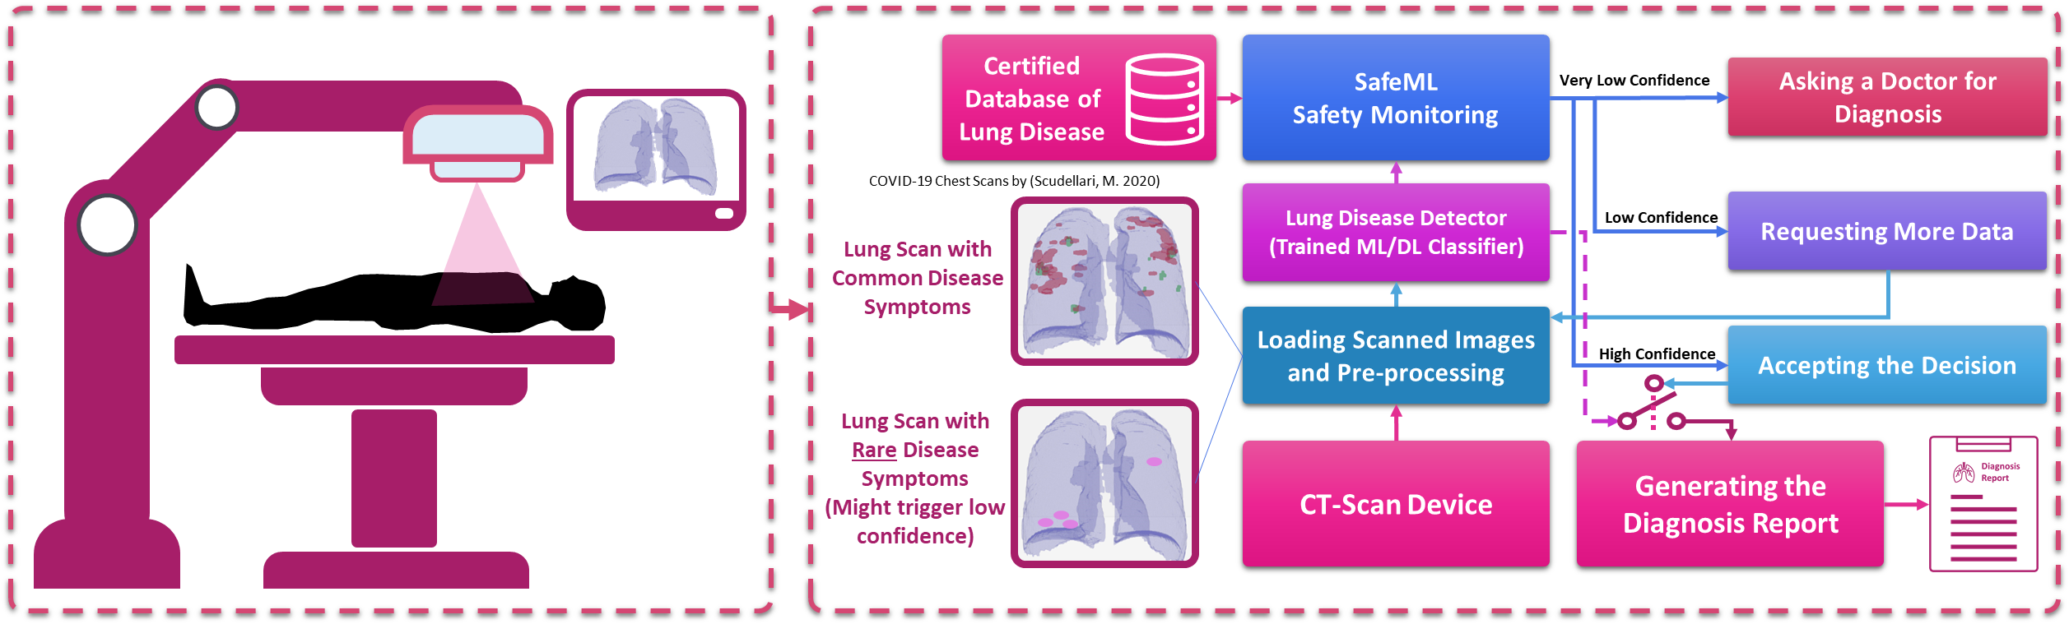
Applications of SafeML – Diagnosis of Lung Disease
45

Slide 46
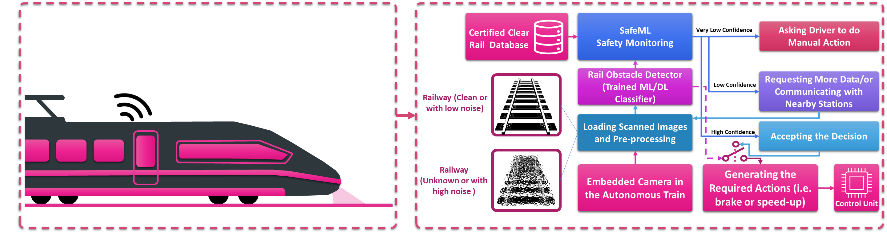
Applications of SafeML - Obstacle Detection on Track
46

Slide 47
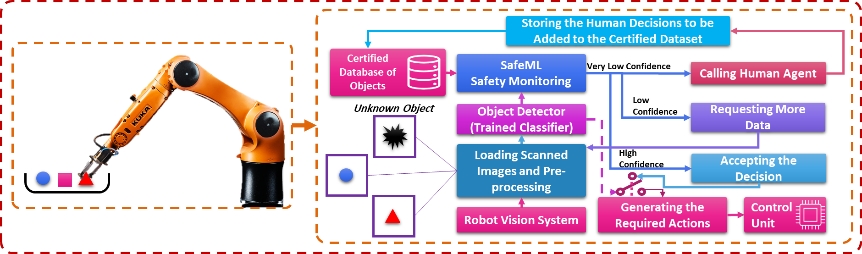
Applications of SafeML – Object Detection and Classification
KUKA Robot Image: https://www.kuka.com/en-us/products/robotics-systems/software/application-software/kuka_visiontech
47

Slide 48




SafeML Reproducibility
https://github.com/ISorokos/SafeML
MATLAB Implementation
Python Implementation
R Implementation
k.aslansefat@hull.ac.uk
48

Slide 49
Conclusion
We have proposed SafeML:
That is useful for concept drift, domain adaptation and distribution shift detection.
Provides a novel safety monitoring and human-in-the-loop procedure.
Has the ability to illustrate the statistical explanations.
It can support a variety of distribution (Exponential and normal distribution families).
49

Slide 50
Selected References
Amodei, D., Olah, C., Steinhardt, J., Christiano, P., Schulman, J., & Mané, D. (2016). Concrete Problems in AI Safety. http://arxiv.org/abs/1606.06565
Burton, S., Habli, I., Lawton, T., McDermid, J., Morgan, P., & Porter, Z. (2020). Mind the gaps: Assuring the safety of autonomous systems from an engineering, ethical, and legal perspective. Artificial Intelligence, 279, 103201. https://doi.org/10.1016/j.artint.2019.103201
Davenport, T. H., Brynjolfsson, E., McAfee, A., James, H., & Wilson, R. (2019). Artificial Intelligence: The Insights You Need from Harvard Business Review. Harvard Business Review.
Fukunaga, K. (1992). Introduction to Statistical Pattern Recognition (Second Edition). Academic Press.
Nielsen, F. (2018). The Chord Gap Divergence and a Generalization of the Bhattacharyya Distance. ICASSP, IEEE International Conference on Acoustics, Speech and Signal Processing - Proceedings, 2018-April, 2276–2280. https://doi.org/10.1109/ICASSP.2018.8462244
Quiñonero-Candela, J., & Schwaighofer, A. (2009). Dataset Shift in Machine Learning. MIT Press.
Schulam, P., & Saria, S. (2019). Can You Trust This Prediction? Auditing Pointwise Reliability After Learning. http://arxiv.org/abs/1901.00403
Zahm, O., Cui, T., Law, K., Spantini, A., & Marzouk, Y. (2018). Certified dimension reduction in nonlinear Bayesian inverse problems. http://arxiv.org/abs/1807.03712
50

Slide 51


More about SafeML
Human-in-the-loop AI. Agency & oversight. (Open Ethics Series, S01E06)
https://www.youtube.com/watch?v=m4szeYSIuRc&t
How to Make Your Classifier Safe
https://towardsdatascience.com/how-to-make-your-classifier-safe-46d55f39f1ad
51

Slide 52

Thank You
If you have any question, please feel free to ask

